Slide 1
Parking Lot System
Cypher

Slide 2
Motivation
Looking for a parking space is really a big issue.
It could take a lot of time.
This problem is our big interest in our project.

Slide 3
Solution
An independent and wise parking lot system that have features :
Parking indicator
Count entering and leaving cars
Display used parking space,
Auto entering gate will be closed (no parking left).

Slide 4
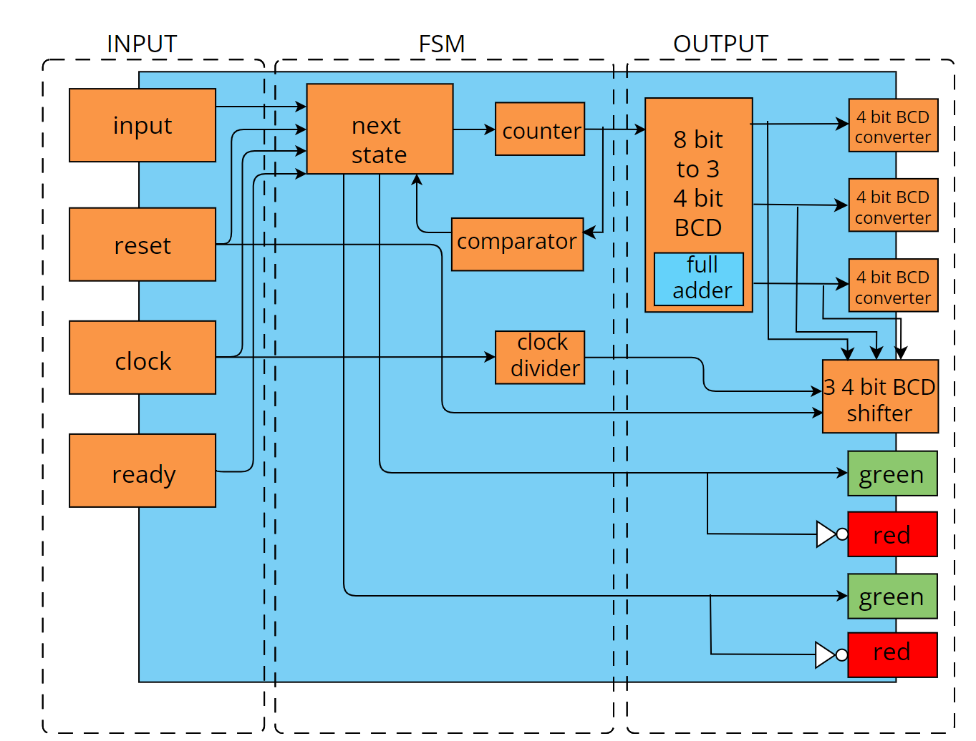
Approach : Model architecture

Slide 5
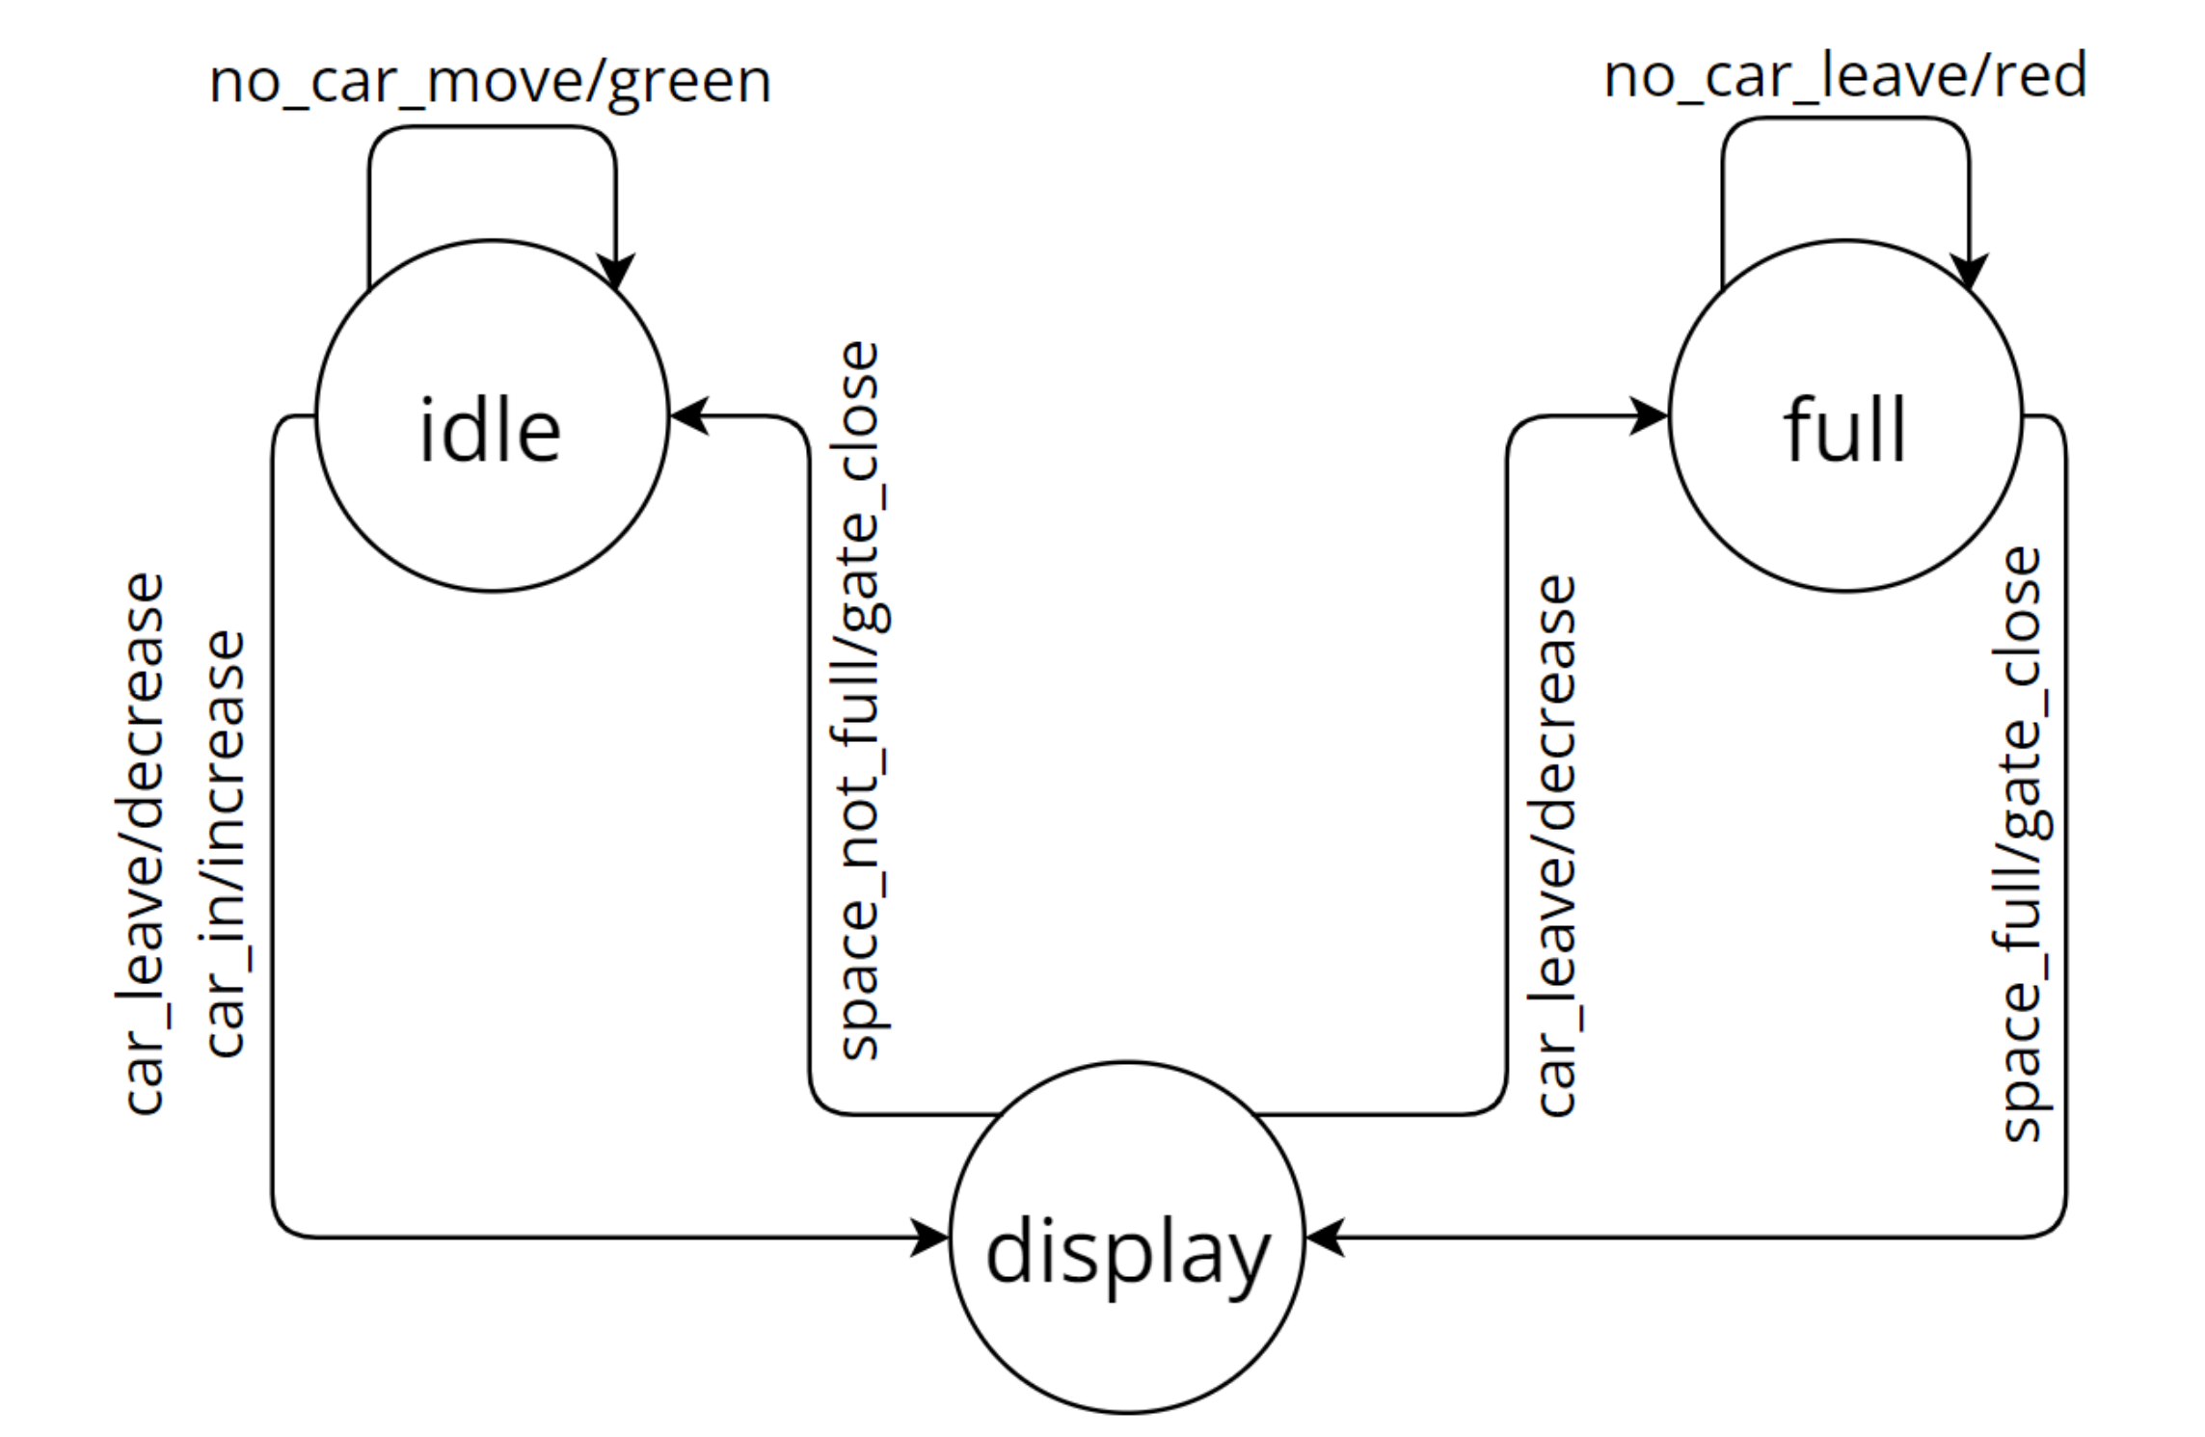
Approach : Model behavioral (FSM)

Slide 6
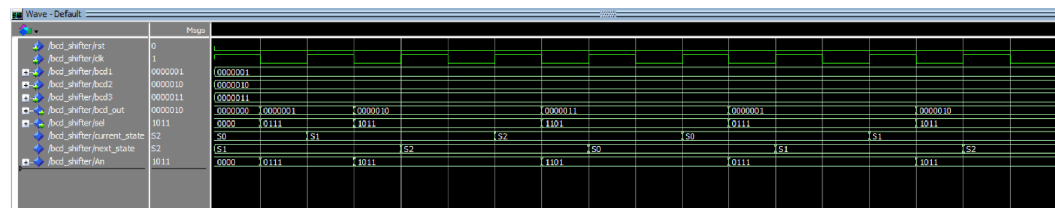
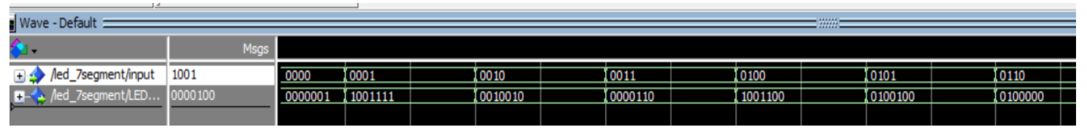
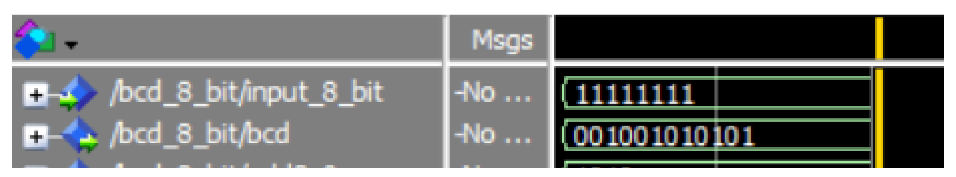
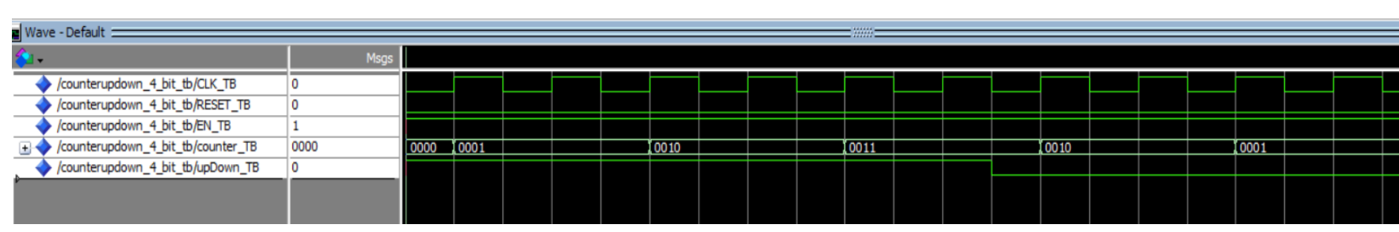
Approach : Model behavioral (VHDL)
Scheduler
7 Segmet
8 bit BCD
Counter

Slide 7
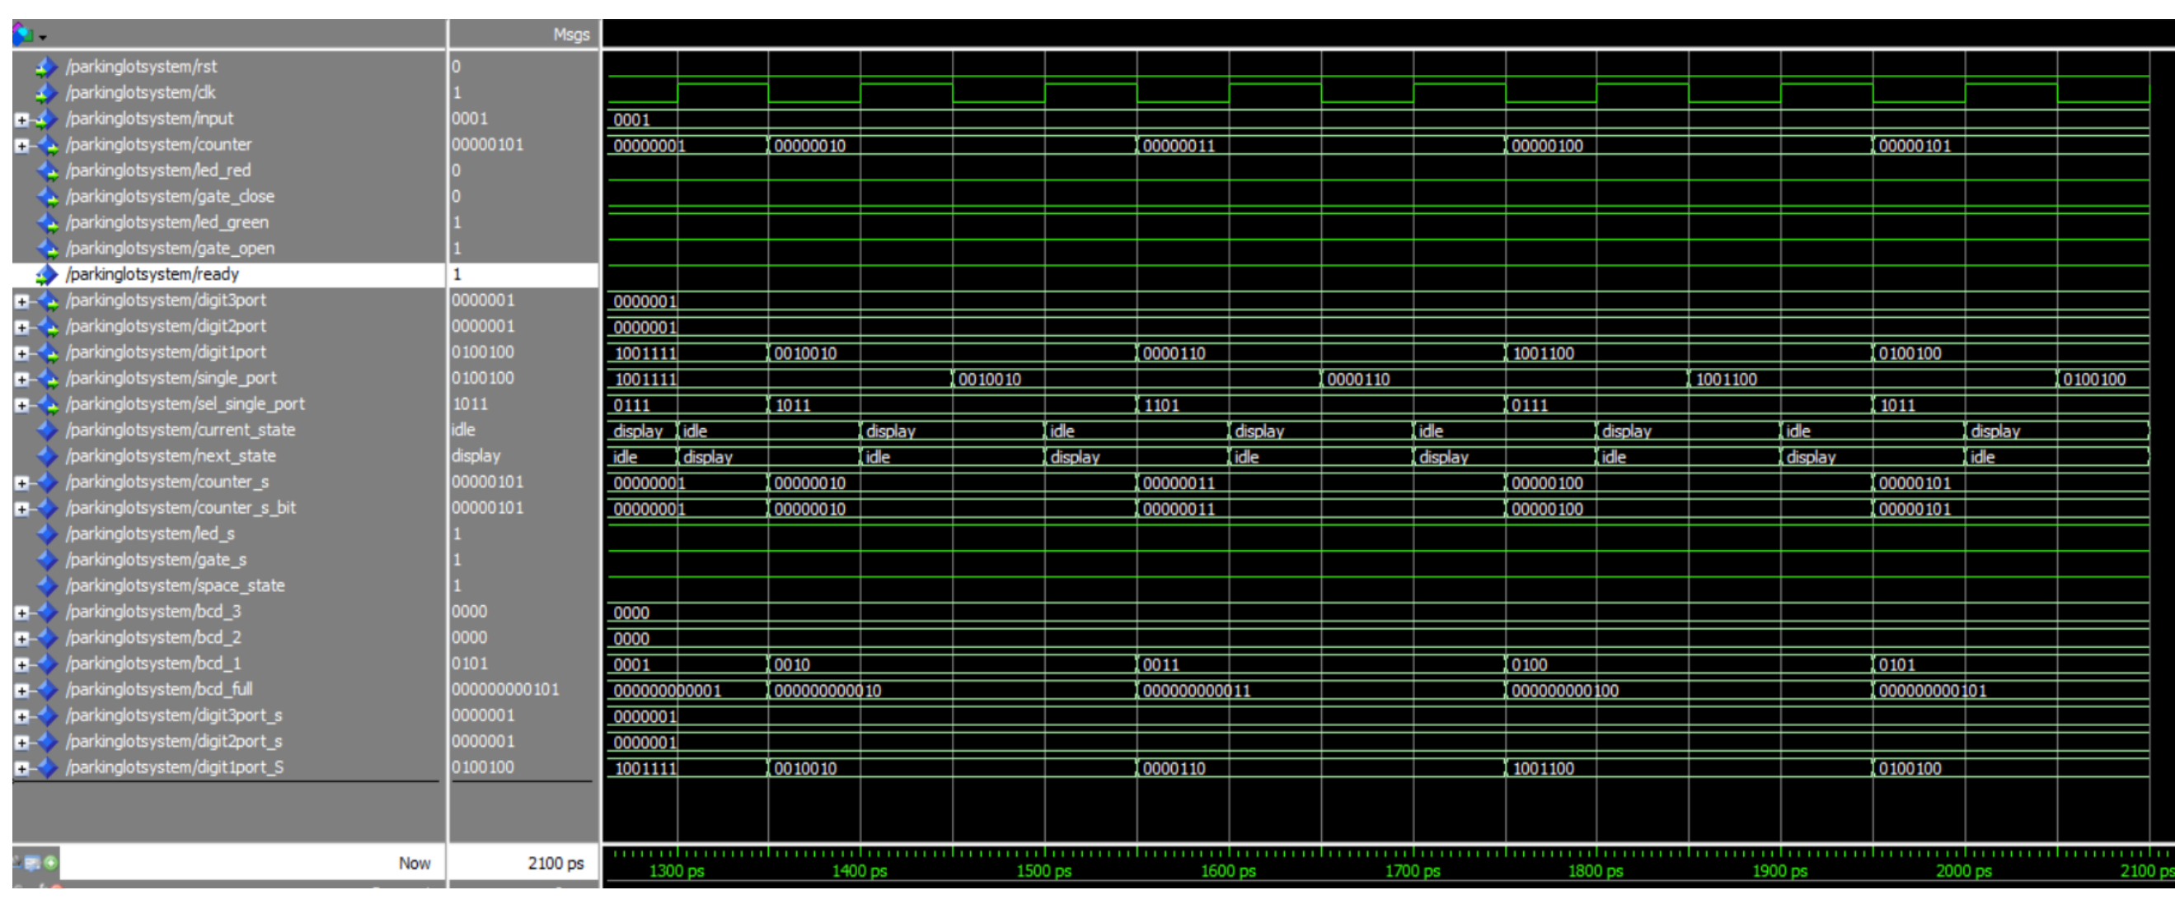
Parking Lot System

Slide 8
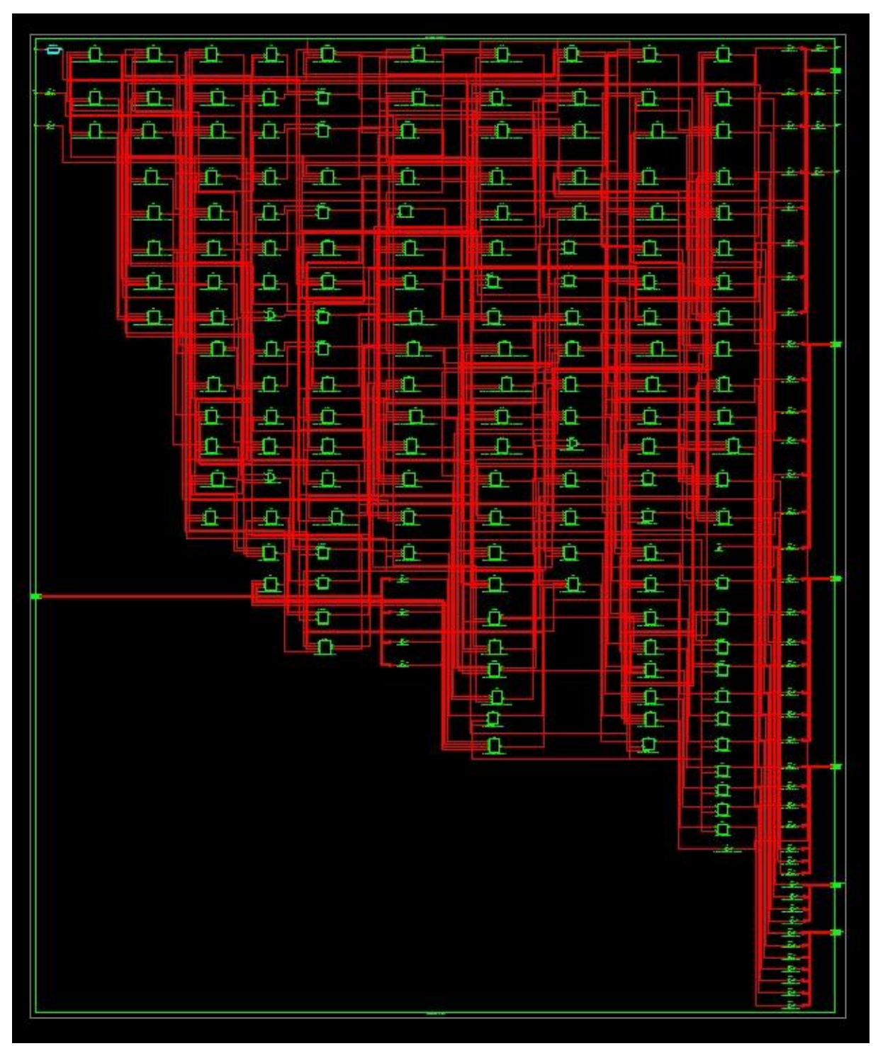
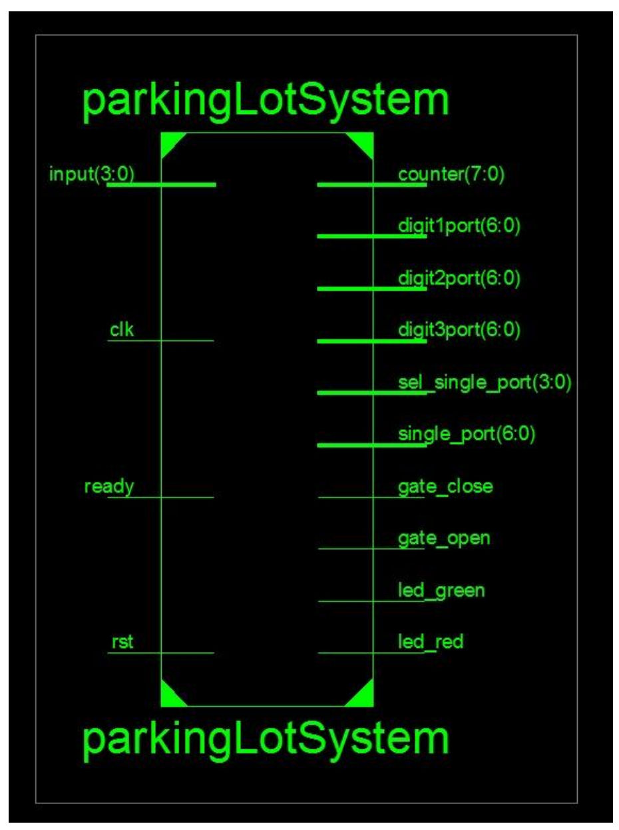
Approach : Synthesis

Slide 9
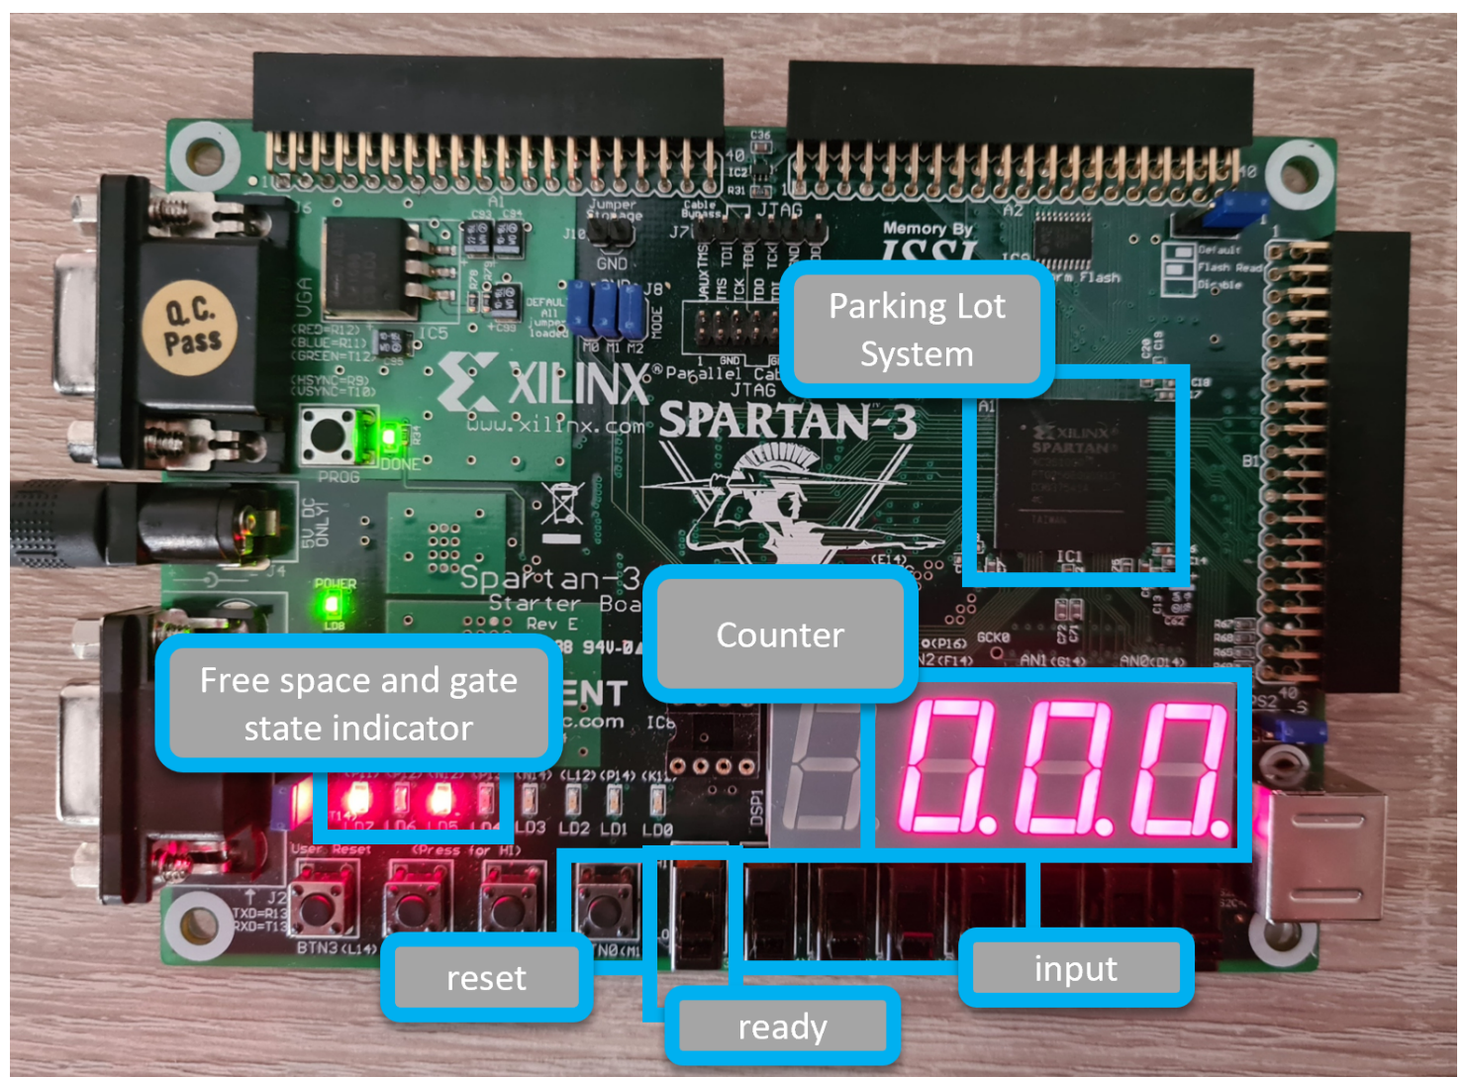
System Implementation

Slide 10
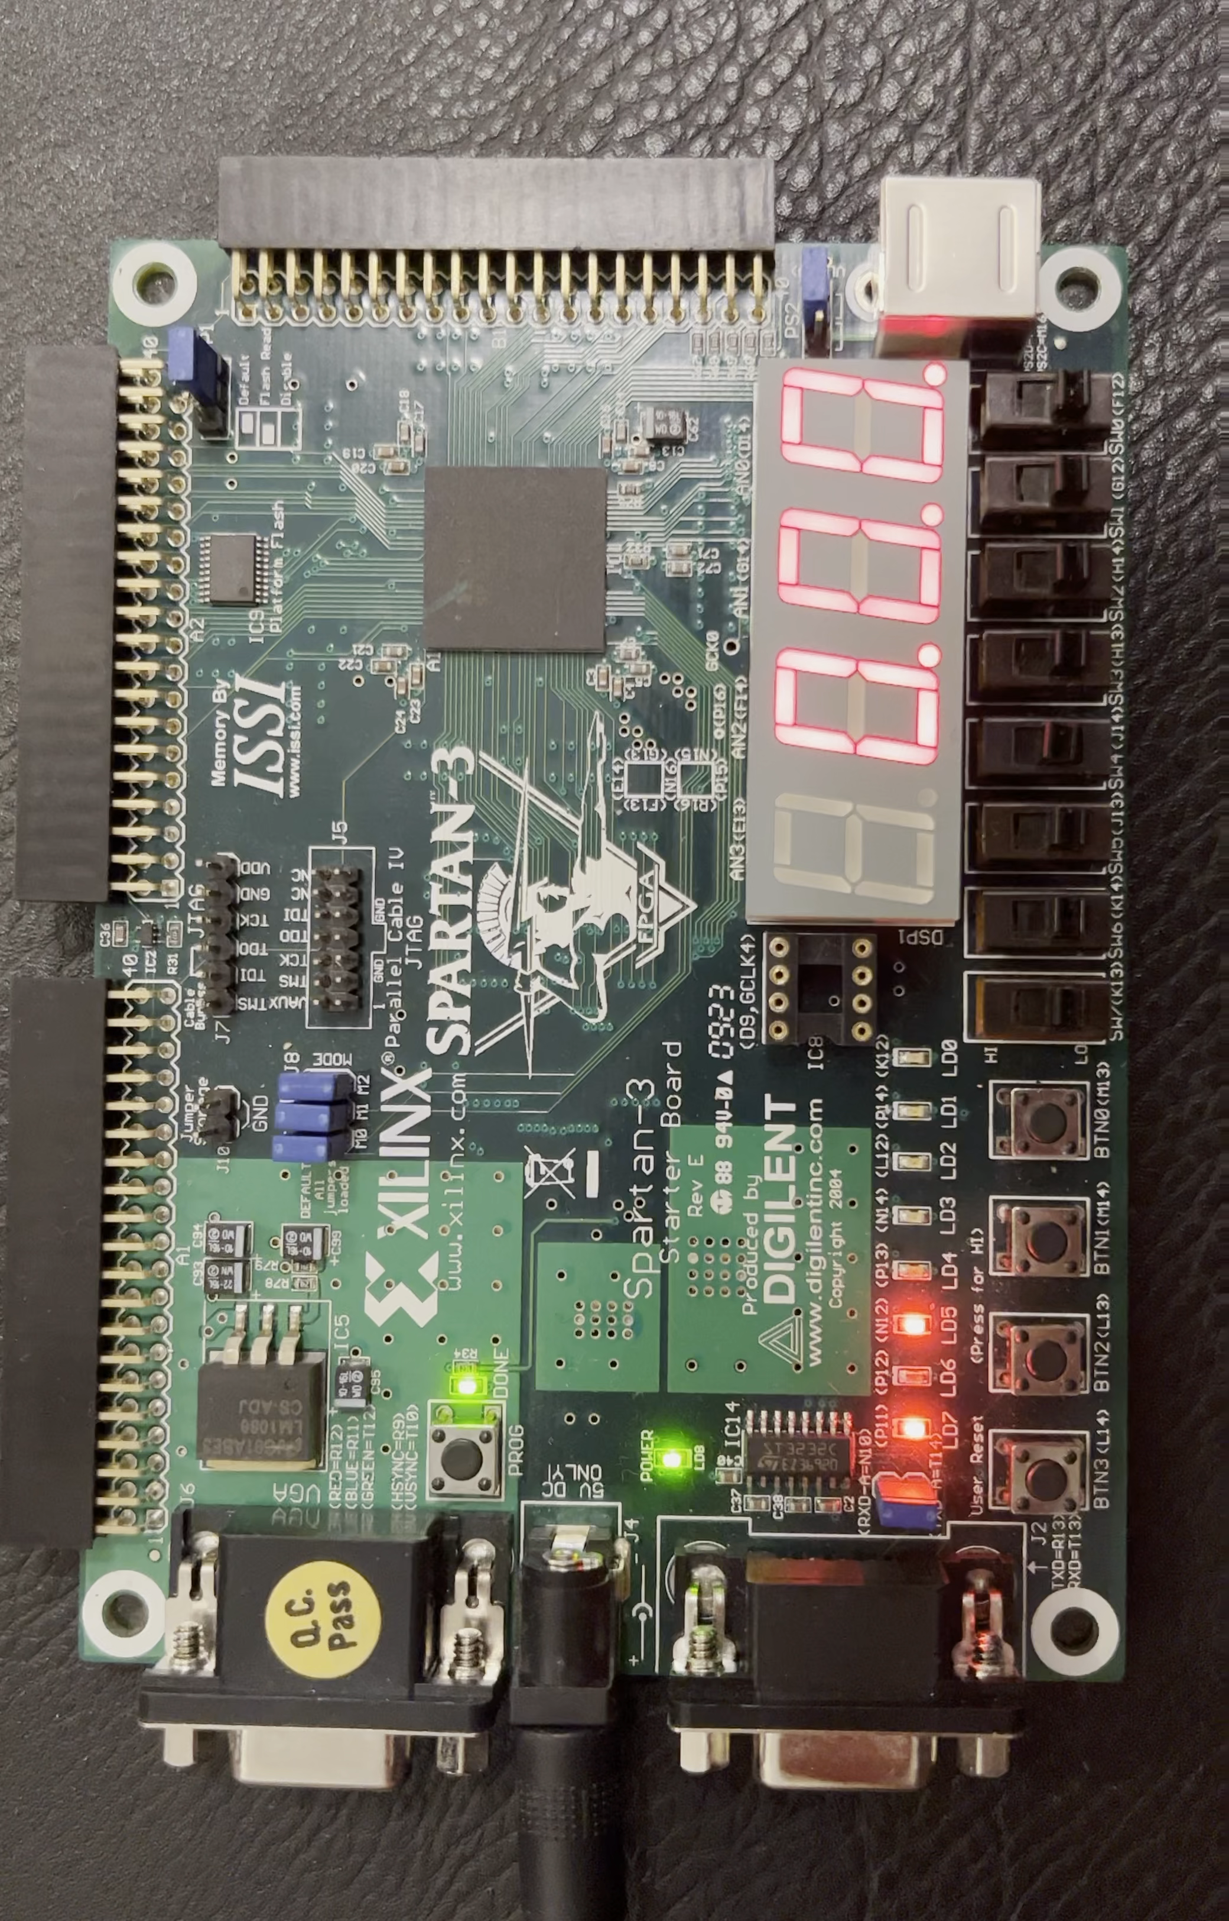
Simulation

Slide 11
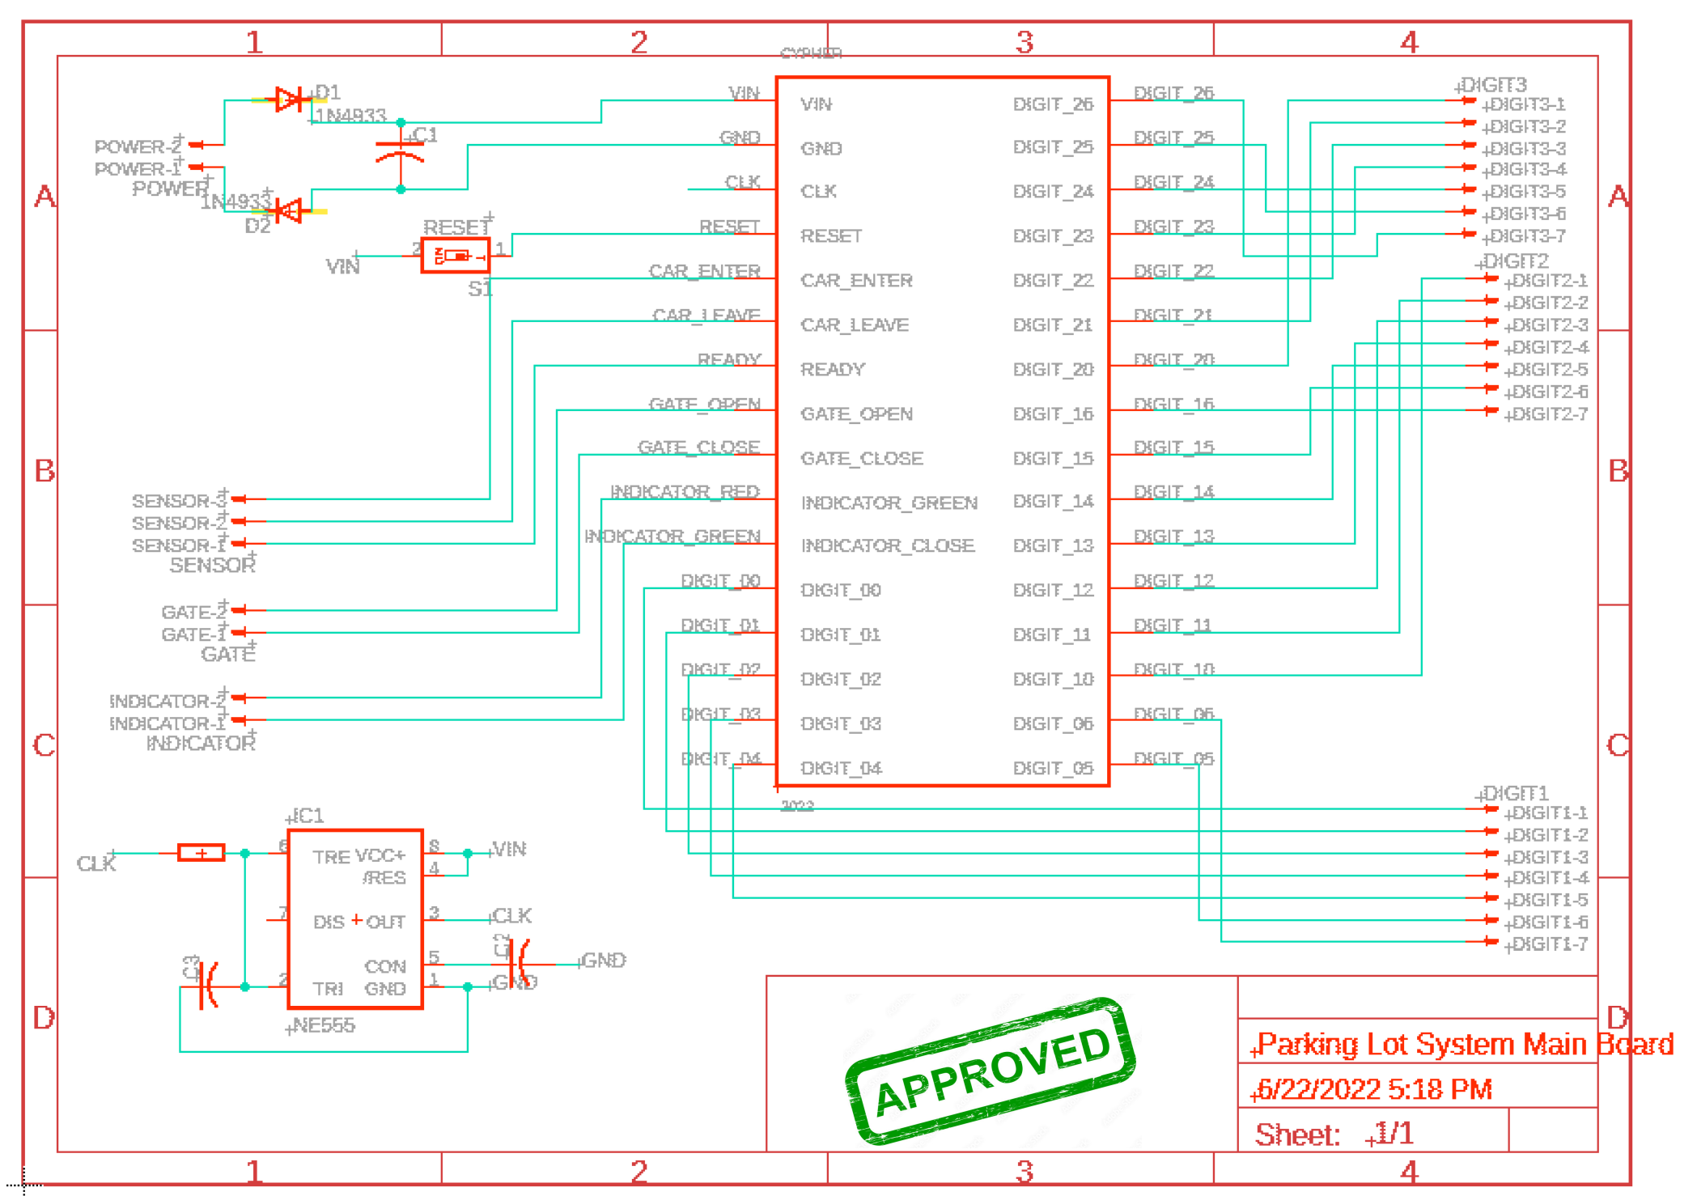
PCB Design Approach

Slide 12
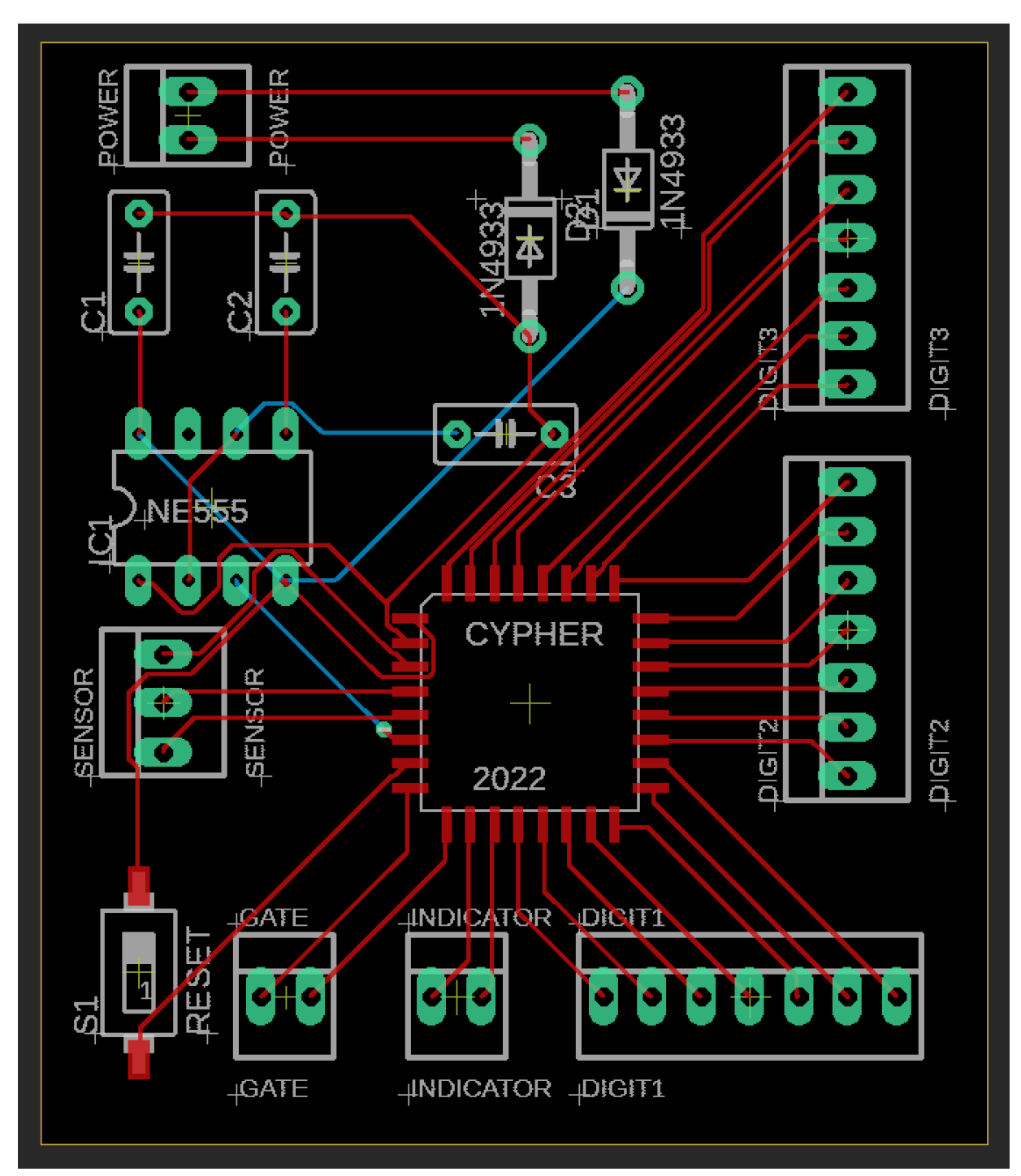
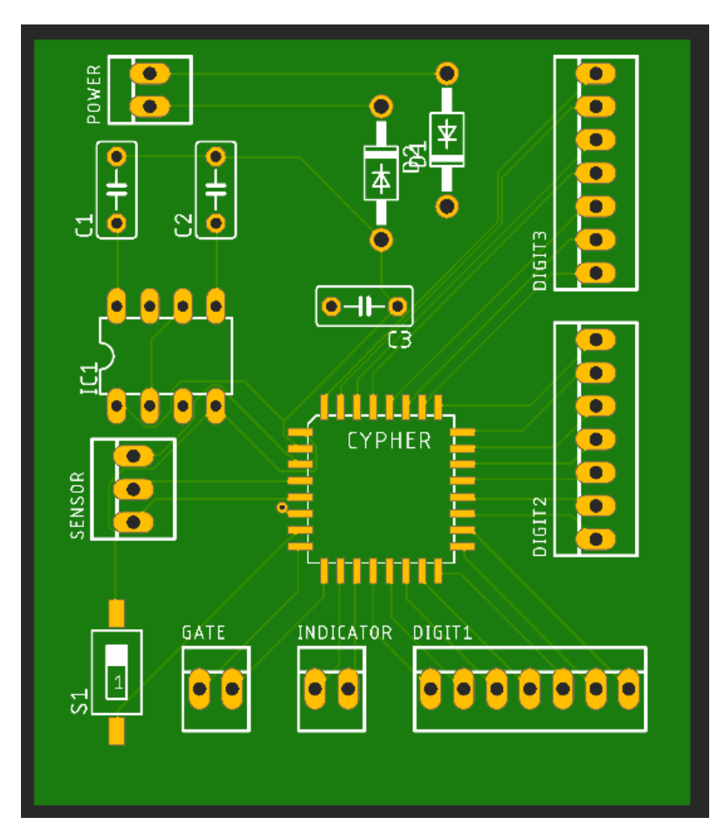
PCB Design

Slide 13
Conclusion
Successfully implement our solution prototype through various advance approach and technologies
Independent System

